Slide 1
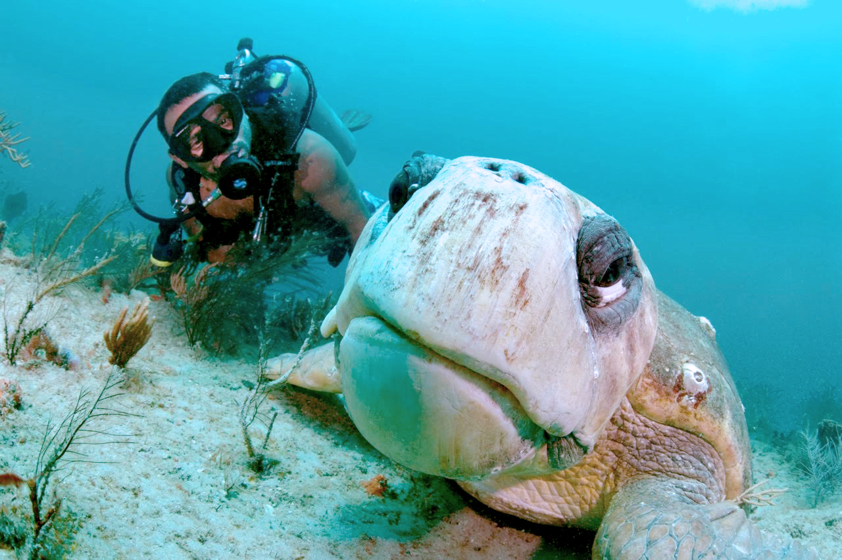
WATCH Your scuba diving
by: Security Application Via Engineering AS

Slide 2
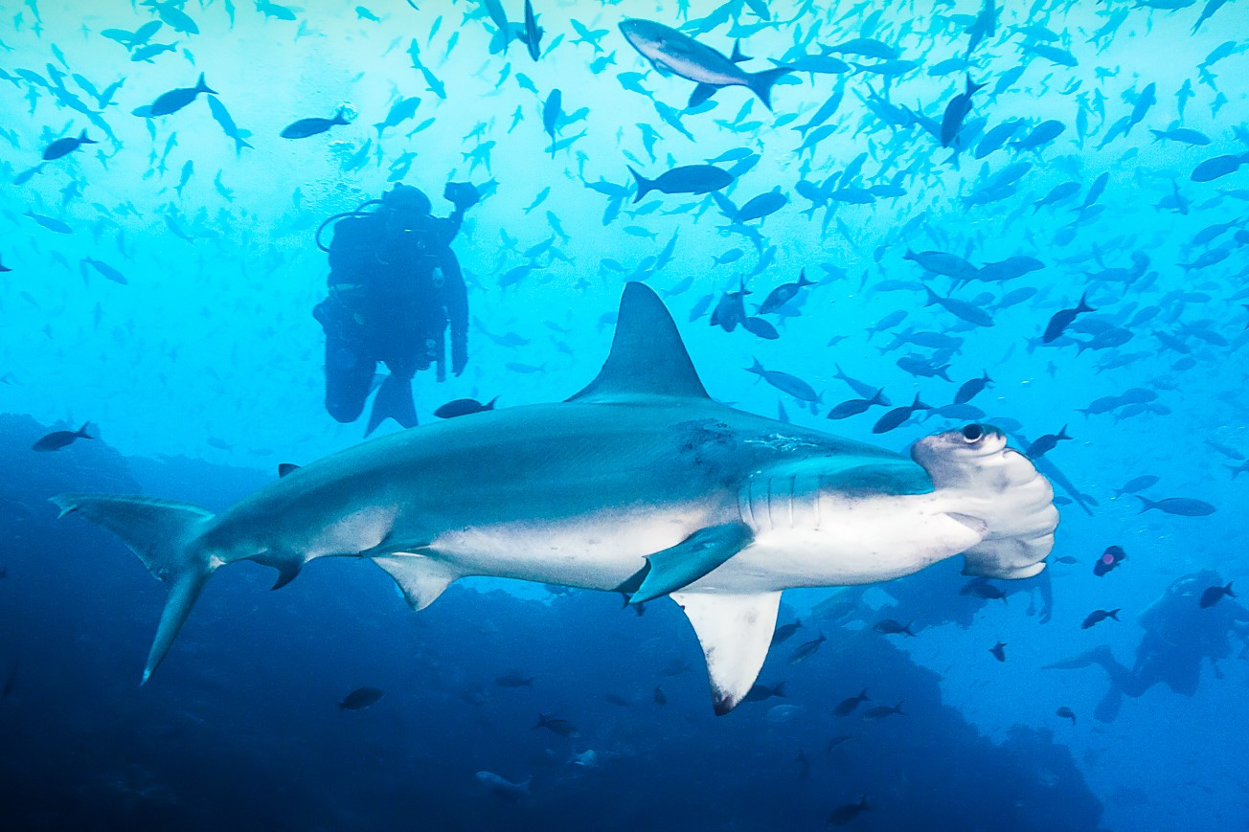

Slide 3
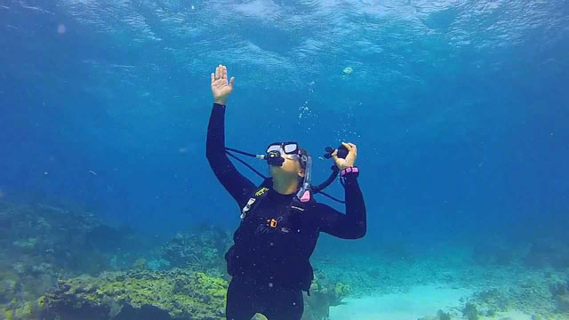

Slide 4
We need to find a safe, reliable, user-friendly oxygen information/warning system which provides for the general scuba diver a more secured and independent diving experience.

Slide 5
Business opportunity:
Provide scuba diving experience for amateur individuals that can be more independent from the expertise required to have a safe scuba diving tour.
The opportunity doesn’t need to just be limited to amateur scuba divers, but also the more experienced one in the manner of a more worry-free diving. To perform a highly efficient diving activity. The diver should not be required to constantly check the regulator which reduces stress and make them focus more on the task itself.
Larger oxygen tanks/capacity can be applied due to mind-free low-level oxygen risk warning.

Slide 6
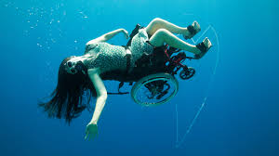

Slide 7
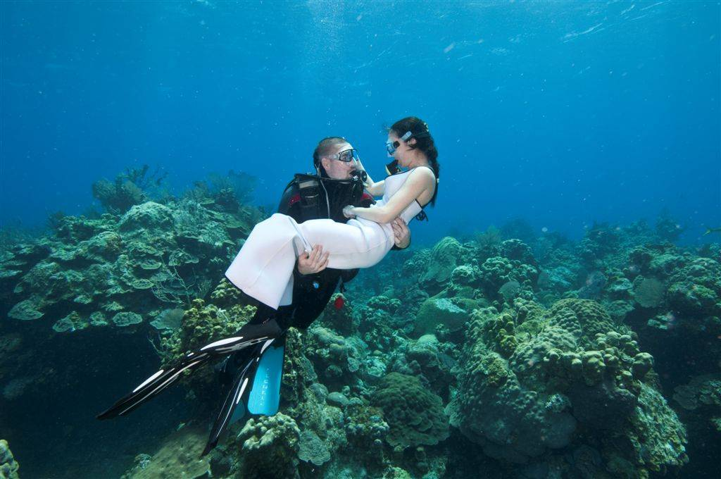

Slide 8
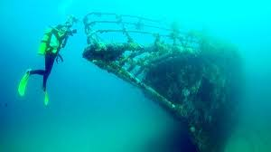

Slide 9
Statement of the goals and objectives of the system:
to ensure a reliable and safe warning system for novel divers. To enhance their diving experience by reducing stress
CONOPS

Slide 10
Boundaries of the system and its external interfaces.
Deep sea level
Based on existing products
CONOPS

Slide 11
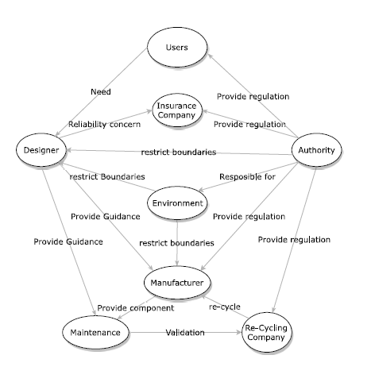
Stakeholders (and interactions between them).
CONOPS

Slide 12
Policies and/or constraints that affect the system or that influence it.
Encouragement of Scuba Diving Business
Product regulation
Environment regulation
CONOPS

Slide 13
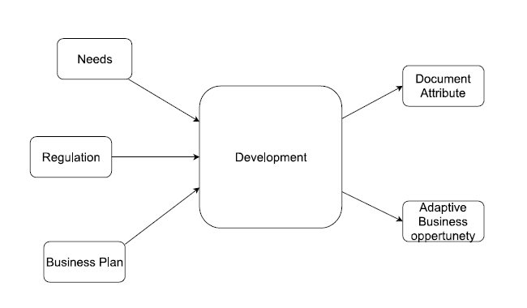
Conceptual view of the system
To make sure the safety of the user
To provide scuba diving experience for a wide range of users
CONOPS

Slide 14
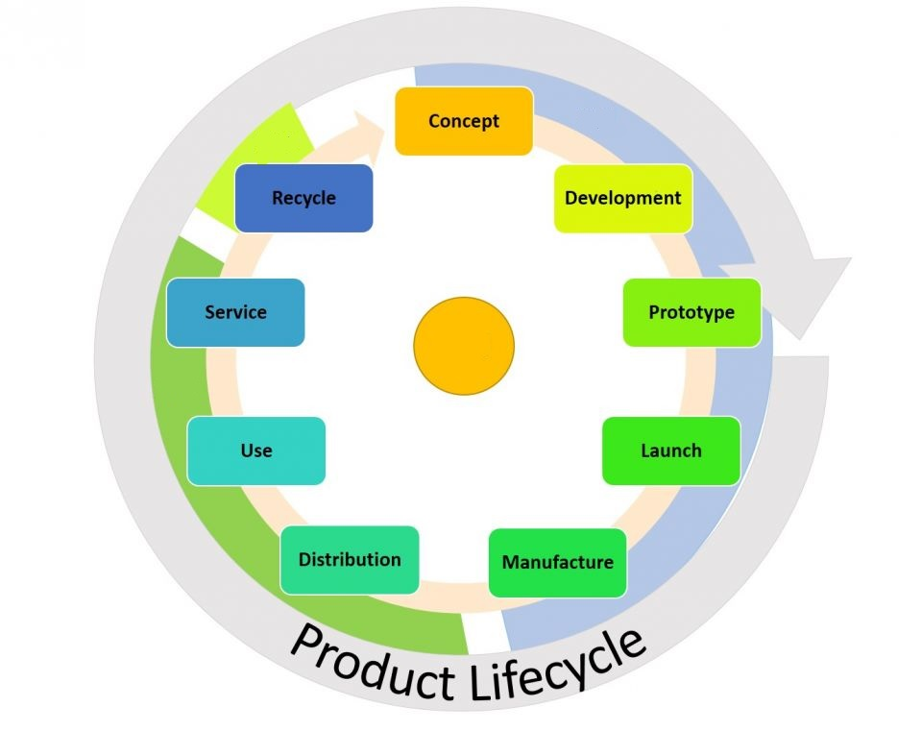

Slide 15
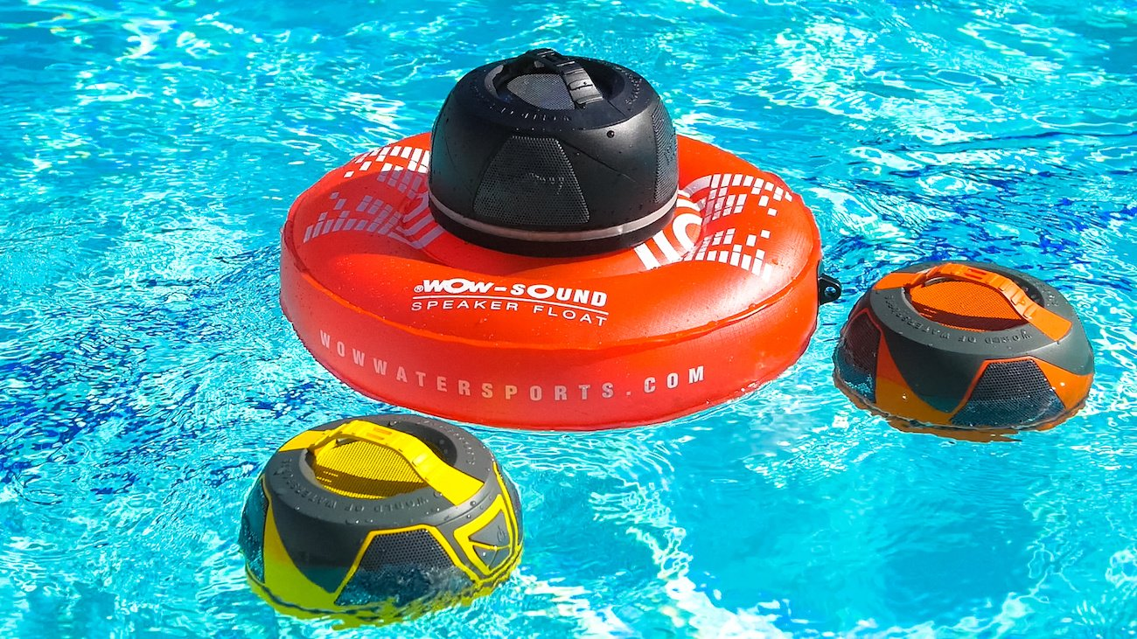
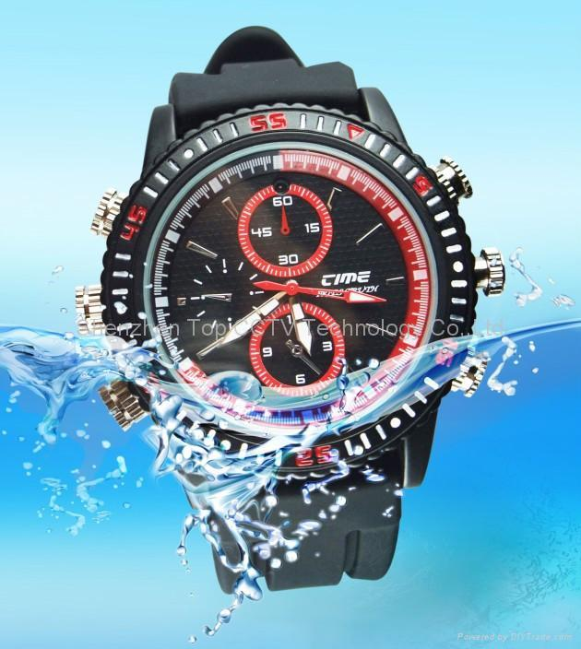
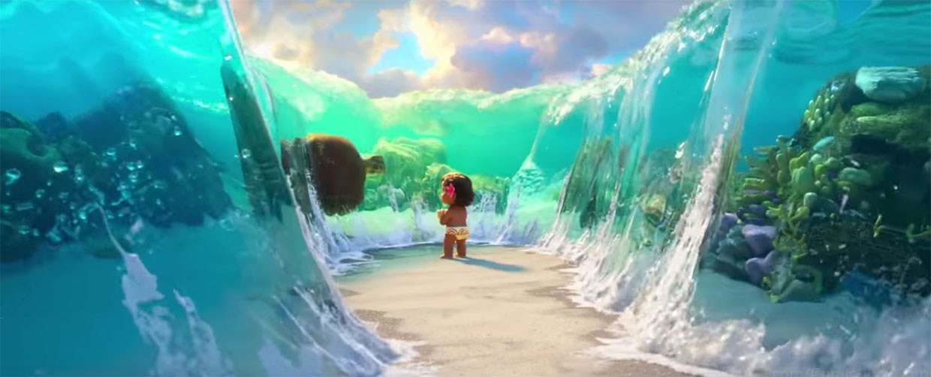
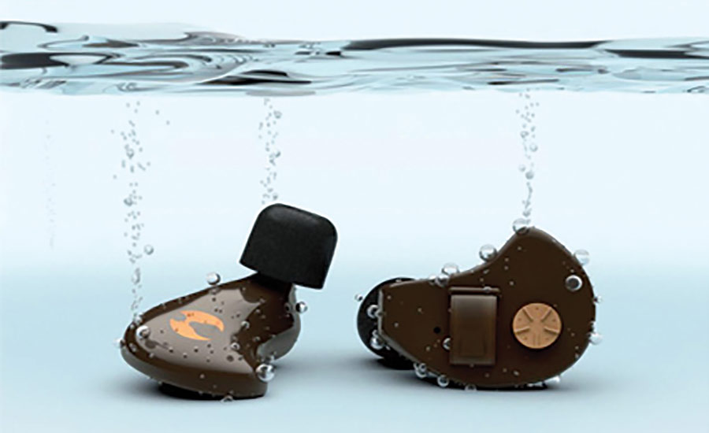
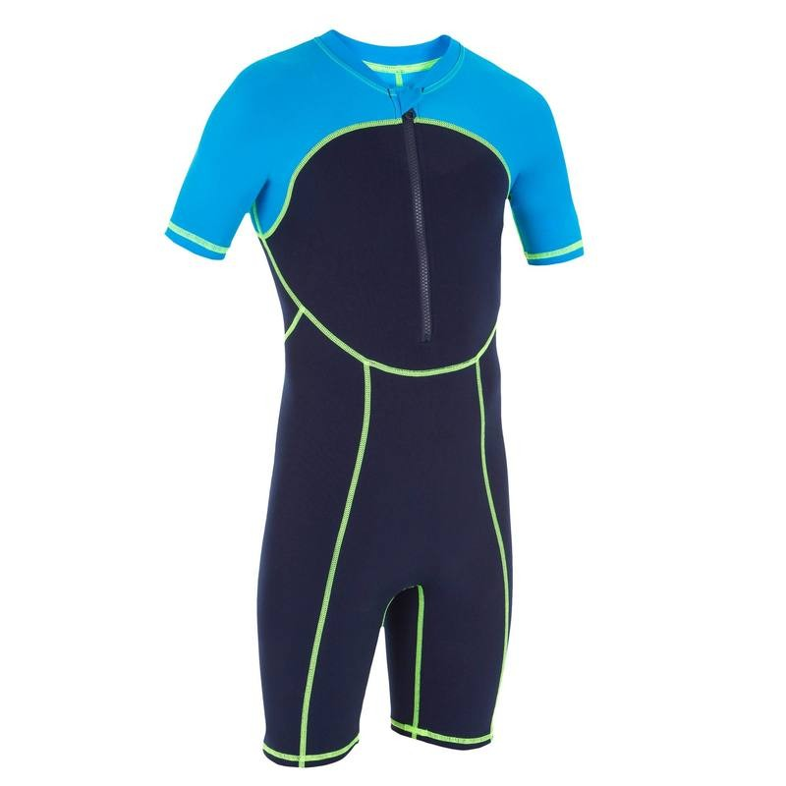
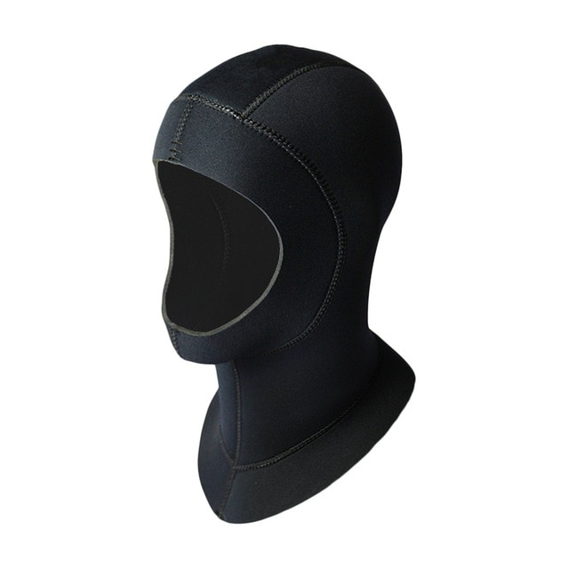
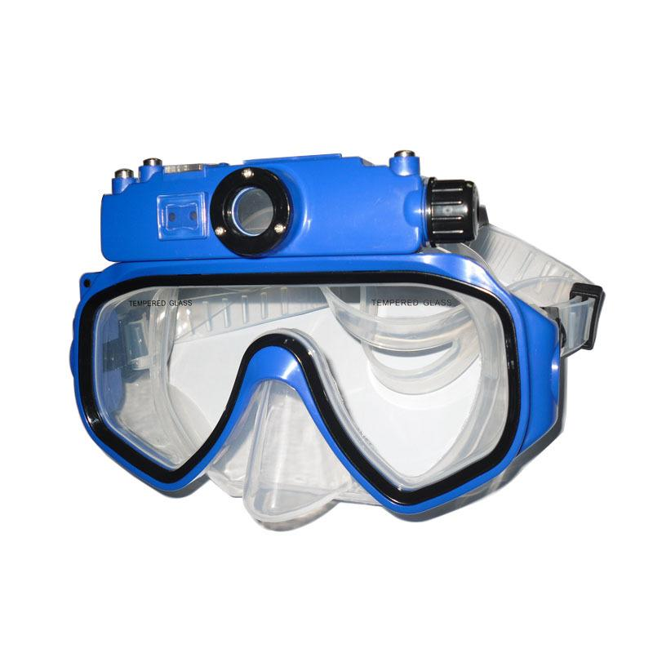
hb
CONCEPTS

Slide 16
Criteria
Criteria | Sound |  | Vibration |  | Flashlight |  | Light & Vibration
 | Speaker | earplugs | Watch | hat | Watch | Glasses | Watch
Reliability | - | - | + | + | S | + | +
Initial cost | - | - | + | - | + | S | +
Efficient | - | + | S | + | S | + | +
Endurance | + | - | S | - | S | S | -
Safety | - | - | + | - | + | + | +
Mobility | - | + | + | - | + | + | +
Complexity | - | - | S | - | + | - | S
∑(+) | 1 | 2 | 4 | 2 | 4 | 4 | 5
∑(-) | 6 | 5 | 0 | 5 | 0 | 1 | 1
∑(S) | 0 | 0 | 3 | 0 | 3 | 2 | 1

Slide 17
System requirement
ID | System Requirement | Requirement origin | Verification | SH Code | Type | Priority
SYSR1 | The system must be able to withstand a certain pressure range. | SHR3, SHR12 | Use pressure tank to verify the system’s threshold. Development | US, MT | NFR | URG
SYSR2 | The system must be able to be water resistant | SHR5, SHR12 | Inspection of system under water level. | DS, MT | NFR | BLC
SYSR3 | The system has to be rust free. | SHR5, SHR9, SHR 11 | Salt spray test | DS, EVM, MF, MT | NFR | NOR
SYSR4 | The system must emphasize warning regarding to low oxygen level | SHR2, | inspection | US, AT | FR | BLC
SYSR5

